Slide 1

Toys Manufacturing
Business plan

Slide 2
Mission
To create innovative, educational, and sustainable toys that spark imagination and foster development in children.

Slide 3
Market Analysis
Age Group
Kids aged 0-14 years
Demographics
Parents and guardians who prioritize sustainability and educational value in toys
Geographic Focus
Urban and suburban areas with higher awareness of eco-friendly products

Slide 4
Market Size and Growth Potential
The global toy market is projected to reach $120 billion by 2025 of which $2billion will be Indian domestic market, with a significant portion driven by demand for sustainable and educational toys.
Increasing awareness of environmental issues is leading to a growing preference for eco-friendly products among consumers.
India’s toy market has potential to double to $2 bn by 2025: Report | Mint

Slide 5
Key Trends in the Toy Industry
Sustainability: Rising demand for toys made from natural, non-toxic, and biodegradable materials.
Educational Toys: Parents are increasingly seeking toys that offer developmental benefits, such as art kits and DIY projects that enhance creativity and problem-solving skills.
Customization and Personalization: Consumers are looking for toys that can be customized to fit their child’s interests and developmental stage.
Digital Integration: While maintaining a focus on physical play, there is a trend towards integrating digital elements to enhance the play experience.

Slide 6
Competition
Major players in the market include companies like LEGO, Melissa & Doug, and Green Toys, which are known for their commitment to sustainability and educational value.​
There is a growing number of startups and small businesses entering the market with innovative and eco-friendly toy options.
Smartivity: Offers STEM-based educational toys that focus on science, technology, engineering, and math.
Flintobox: Provides theme-based activity boxes for kids on a subscription basis.
Butterfly Edufields: Focuses on hands-on learning for K-12 students with various educational kits.
ClassMonitor: A mobile-based application offering learning kits and skill boosters for young children.
Magic Crate: Delivers DIY activity kits with different themes each month.
Einstein Box: Subscription-based platform for children's books and activities
TechShiksha: Activity-based STEM learning platform for students.

Slide 7
key challenges
Fragmentation and Unorganized Sector: The industry is highly fragmented, with around 90% of the market being unorganized. This fragmentation leads to inefficiencies in the supply chain and limits the ability to scale and innovate.
Lack of Technology: Many domestic toy manufacturers use outdated technology and machinery, which affects the quality and design of the toys. There is also a lack of advanced manufacturing techniques like 3D prototyping.
Lack of Infrastructure: The industry suffers from inadequate infrastructure, including testing labs, toy parks, and clusters. This lack of infrastructure hampers the ability to produce high-quality toys that meet international standards.
High Import Duty on Machinery: Small toy manufacturers struggle to afford the high import duties on machinery needed to produce electronic and battery-operated toys.
Regulatory Challenges: Compliance with stringent quality standards and obtaining necessary certifications can be challenging, especially for small and medium enterprises

Slide 8
Product Line (First Phase)
Puzzles
Animal puzzles (farm, jungle, etc.) Vehicle puzzles (cars, trucks, airplanes) Alphabet puzzles Number puzzles
DIY Kits
Build-your-own wooden vehicles (cars, boats, planes) Create-your-own dollhouses Design-your-own jewelry sets Make-your-own musical instruments (drums, xylophones)
Educational Games
Matching games (shapes, colors, animals) Memory games Board games (simple versions)

Slide 9
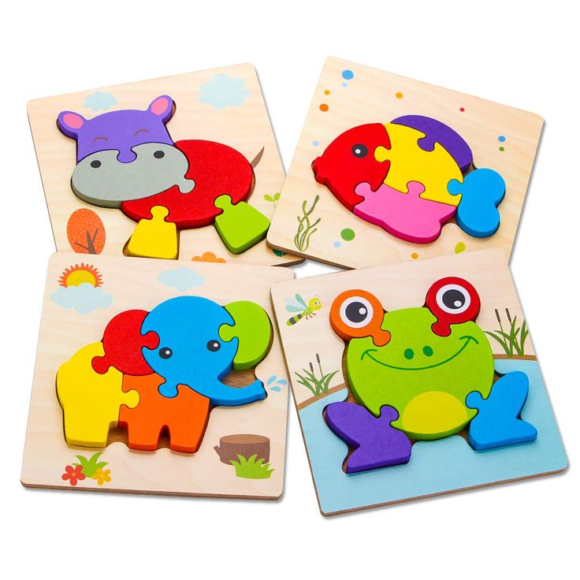
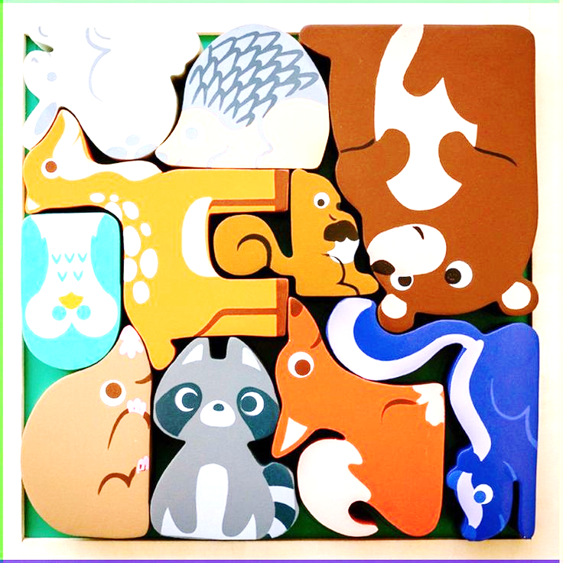
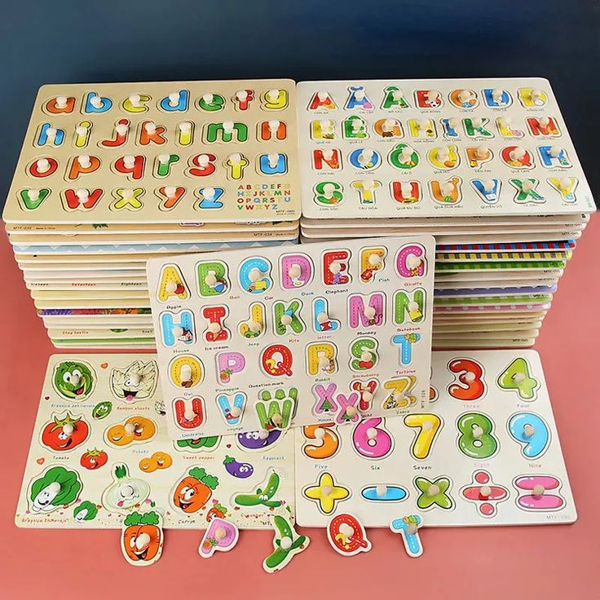
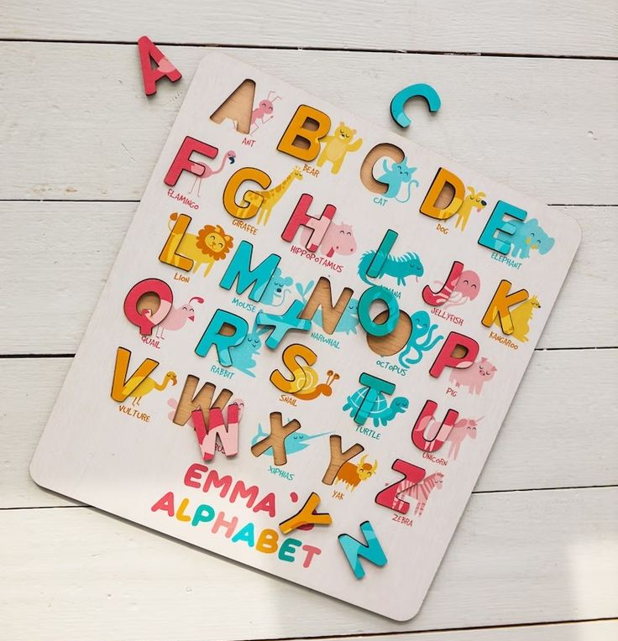
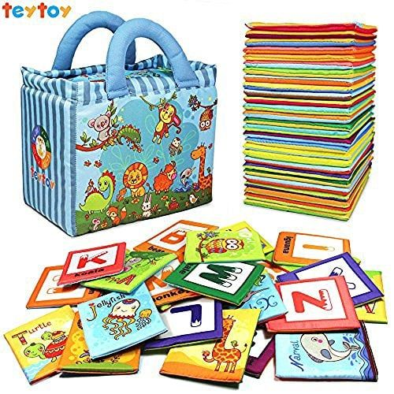
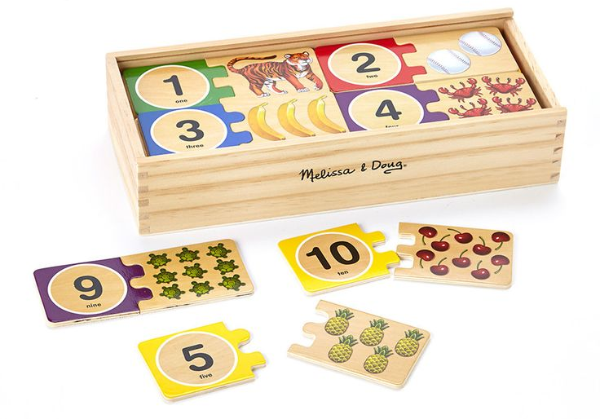
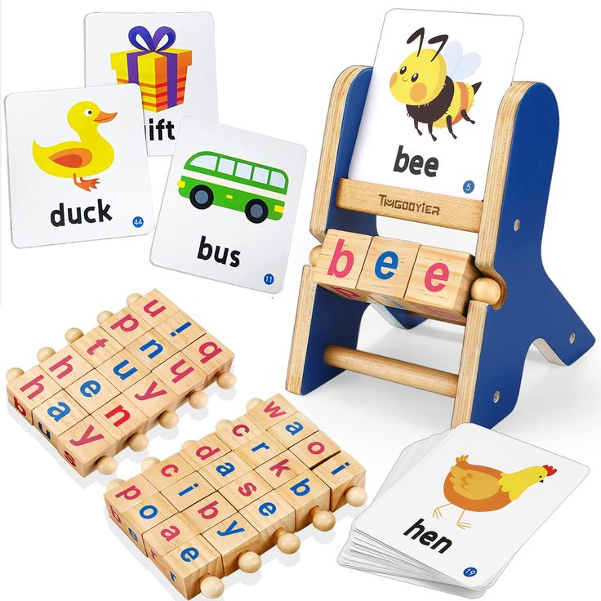
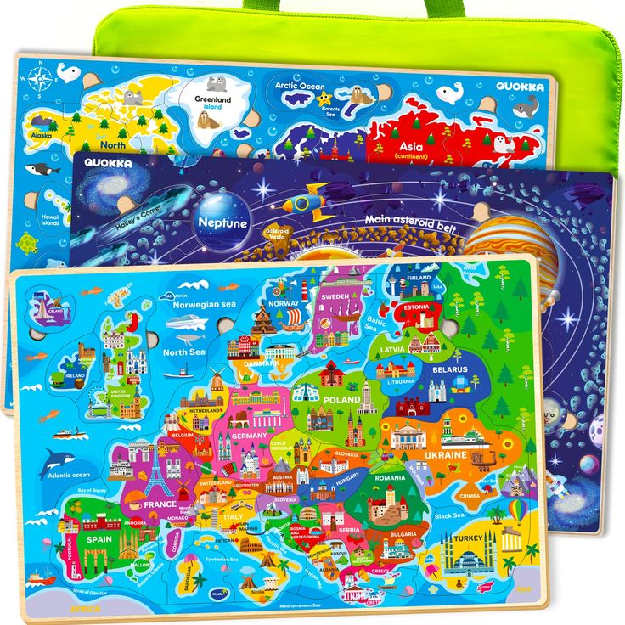
Sample Toys - Puzzles

Slide 10
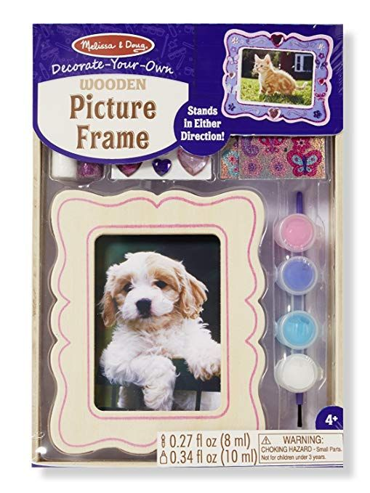
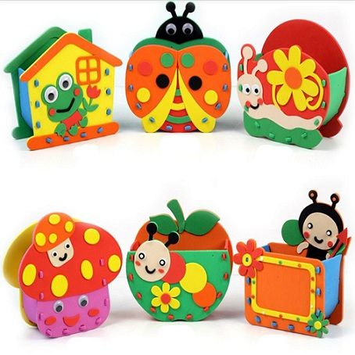
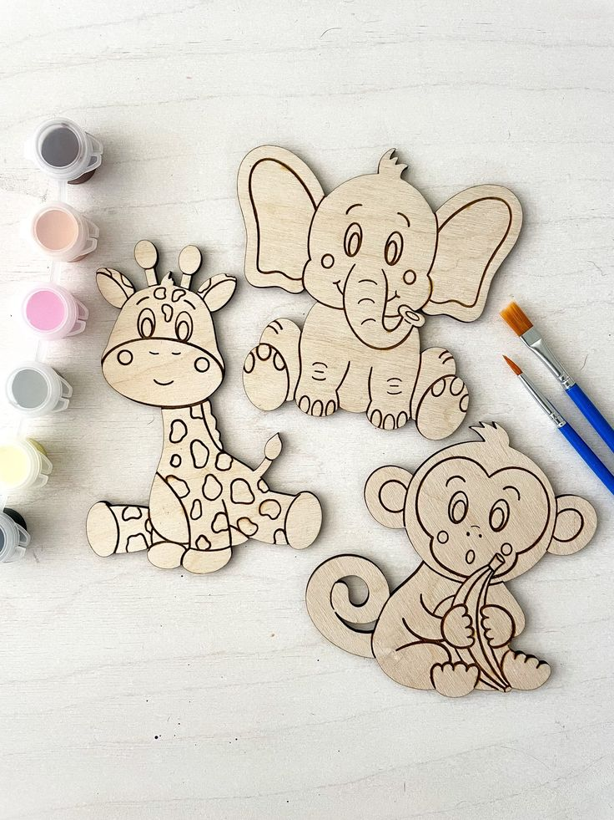
Sample Toys - DIY Kits

Slide 11
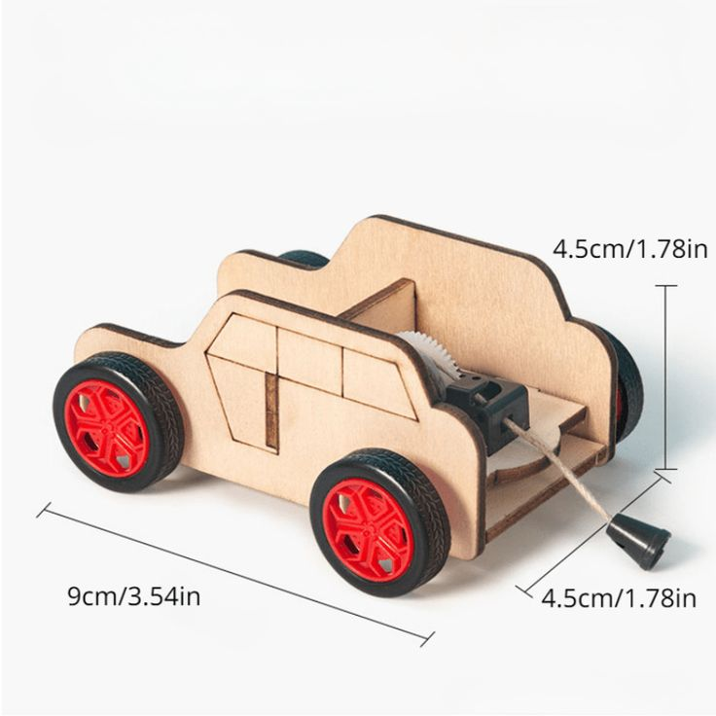
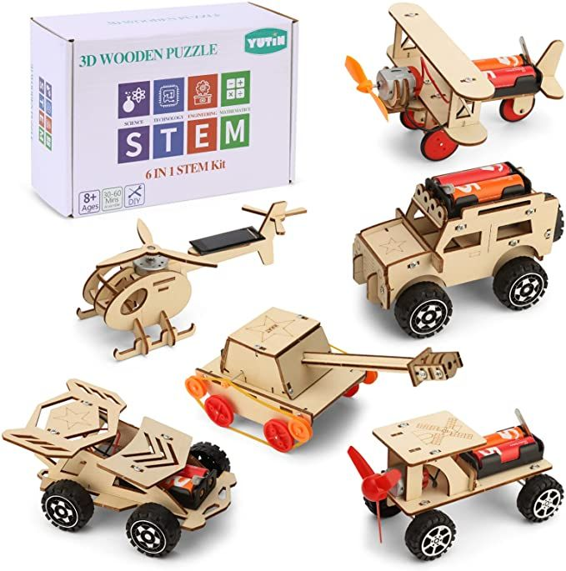
Sample Toys - Puzzles

Slide 12
Addl. CAPEX REQUIREMNT
3x5 Ft. Laser Machine Rs.4.5 lakhs
4X8 CNC Wooden Router Rs.4.0 Lakhs
2X3 Flatbed UV Printer Rs.8.0 Lakhs (+3-4Lakhs)

Slide 13
Sales Projections
Rs. In Lakhs

Slide 14
Cash flows
Quarter | Sales | Material Cost | Labour Cost | Marketing Cost | Cash Flow | Cumulative Cash Flow
Q1 | 55 | 16.50 | 19.25 | 55.00 | -35.75 | -35.75
Q2 | 122 | 36.60 | 30.26 | 80.17 | -25.03 | -60.78
Q3 | 190 | 57.00 | 34.20 | 59.71 | 39.09 | -21.69
Q4 | 257 | 77.10 | 46.26 | 51.40 | 82.24 | 60.55
Year 1 | 624 | 187.20 | 129.97 | 246.29 | 60.55 | 60.55
Q1 | 325 | 97.50 | 102.70 | 287.86 | -163.06 | -102.51
Q2 | 392 | 117.60 | 83.89 | 212.80 | -22.29 | -124.80
Q3 | 460 | 138.00 | 82.80 | 92.00 | 147.20 | 22.40
Q4 | 527 | 158.10 | 94.86 | 105.40 | 168.64 | 191.04
Year 2 | 1704 | 511.20 | 364.25 | 698.06 | 130.49 | 191.04
Q1 | 595 | 178.50 | 167.79 | 459.00 | -210.29 | -19.25
Q2 | 662 | 198.60 | 119.16 | 283.71 | 60.53 | 41.28
Q3 | 730 | 219.00 | 131.40 | 146.00 | 233.60 | 274.88
Q4 | 797 | 239.10 | 143.46 | 159.40 | 255.04 | 529.92
Year 3 | 2784 | 835.20 | 561.81 | 1048.11 | 338.88 | 529.92
Sales considered is net of GST & other taxes
Market Place sales are net of commission and returns
Every New FY launch of New Products combined with aggressive events to add distribution partners

